Slide 1
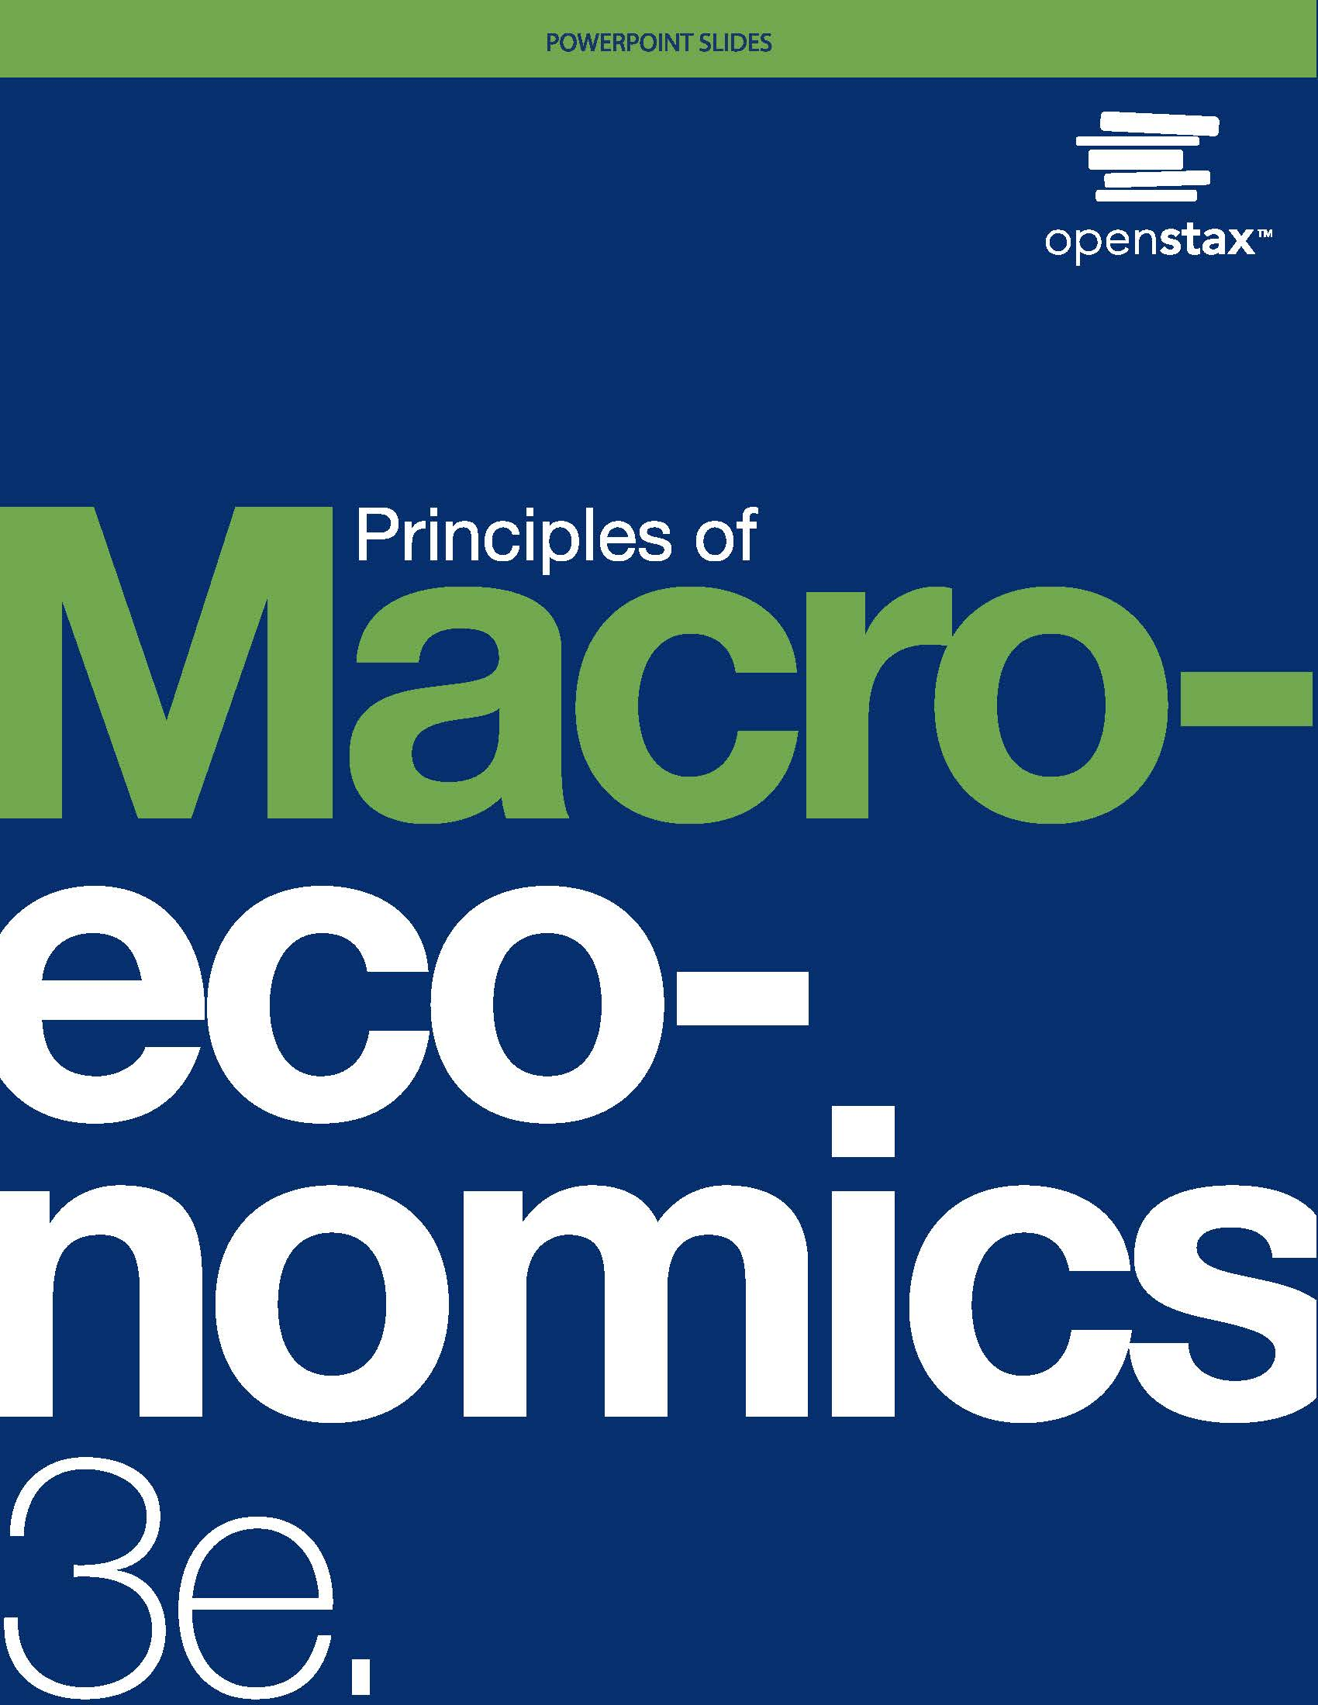
Principles of Macroeconomics 3e
Chapter 15 MONETARY POLICY AND BANK REGULATION
PowerPoint Image Slideshow

Slide 2
Ch.15 OUTLINE
15.1: The Federal Reserve Banking System and Central Banks
15.2: Bank Regulation
15.3: How a Central Bank Executes Monetary Policy
15.4: Monetary Policy and Economic Outcomes
15.5: Pitfalls for Monetary Policy

Slide 3
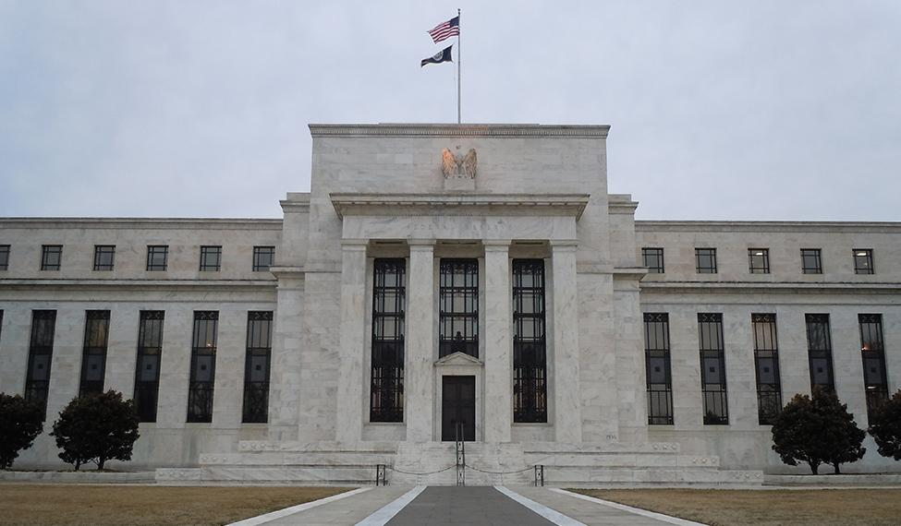
15.1 Marriner S. Eccles Federal Reserve Headquarters, Washington D.C.
Some of the most influential decisions regarding monetary policy in the United States are made behind these doors.
(Credit: modification of “Marriner S. Eccles Federal Reserve” by LunchboxLarry/Flickr Creative Commons, CC BY 2.0)

Slide 4
15.1 The Federal Reserve Banking System and Central Banks
Central bank - the organization responsible for conducting monetary policy and ensuring that a nation’s financial system operates smoothly.
In the U.S. the central bank is the Federal Reserve (“the Fed”).
Semi-decentralized, mixing government appointees with representation from private-sector banks.
Run by a Board of Governors, consisting of seven members appointed by the President of the United States and confirmed by the Senate.

Slide 5
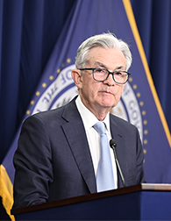
Chair of the Federal Reserve Board
Jerome H. Powell
While the Chair of the Federal Reserve has only one vote, they control the agenda, and is the Fed's public voice.
(Photo Credit: “_NZ79221” by Board of Governors of the Federal Reserve System/Flickr, Public Domain)

Slide 6
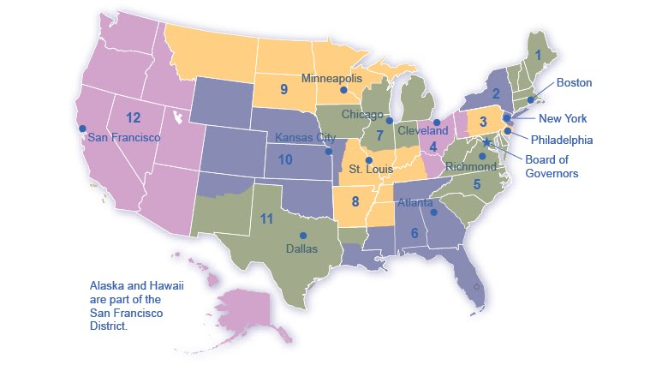
The Twelve Federal Reserve Districts
The Federal Reserve is more than the Board of Governors.
Federal Open Market Committee (FOMC) - makes the decisions regarding open market operations, and is comprised of 7 members of the Federal Reserve’s Board of Governors and 5 voting members from the regional Federal Reserve Banks.
The Fed also includes 12 regional Federal Reserve banks, each of which is responsible for supporting the commercial banks and economy generally in its district.

Slide 7
What Does a Central Bank Do?
The Federal Reserve is designed to perform three important functions:
To conduct monetary policy
To promote stability of the financial system
To provide banking services to commercial banks and other depository institutions, and to provide banking services to the federal government.

Slide 8
15.2 Bank Regulation
Bank regulation is intended to maintain banks' solvency by avoiding excessive risk.
Regulation falls into a number of categories:
reserve requirements
capital requirements
restrictions on the types of investments banks may make.
Regulation requires that banks maintain a minimum net worth, usually expressed as a percent of their assets, to protect their depositors and other creditors.

Slide 9

A Run on the Bank
Bank run - when depositors race to the bank to withdraw their deposits for fear that otherwise they would be lost.
Bank runs during the Great Depression only served to worsen the economic situation. (Credit: “Depression: "Runs on Banks” by National Archives and Records Administration, Public Domain)

Slide 10
Deposit Insurance and Lender of Last Resort
The risk of bank runs can create instability in the banking system.
To protect against bank runs, Congress has put two strategies into place:
Deposit insurance - an insurance system that makes sure depositors in a bank do not lose their money, even if the bank goes bankrupt.
Banks pay an insurance premium to the Federal Deposit Insurance Corporation (FDIC).
Lender of last resort - an institution that provides short-term emergency loans in conditions of financial crisis.

Slide 11
15.4 Monetary Policy and Economic Outcomes
The Federal Reserve's most important function is to conduct the nation’s monetary policy, which influences the level of economic activity.
Two Types of Monetary Policy:
Expansionary monetary policy or loose monetary policy - a monetary policy that increases the supply of money and the quantity of loans.
Contractionary monetary policy or tight monetary policy - a monetary policy that reduces the supply of money and loans

Slide 12
The Effect of Monetary Policy on Aggregate Demand
Monetary policy affects interest rates and the available quantity of loanable funds, which in turn affects several components of aggregate demand.
Tight or contractionary monetary policy will reduce two components of aggregate demand:
Business investment (declines because it is less attractive for firms to borrow money).
Consumer borrowing for big-ticket items.
Conversely, loose or expansionary monetary policy will tend to increase business investment and consumer borrowing for big-ticket items.

Slide 13
15.3 How a Central Bank Executes Monetary Policy
Four "Tools" of Monetary Policy:
The most common monetary policy tool in the U.S. has been:
Open market operations - the central bank selling or buying Treasury bonds to influence the quantity of money and the level of interest rates.

Slide 14
Changing Reserve Requirements
A second method of conducting monetary policy is for the central bank to raise or lower the reserve requirement.
Reserve requirement - the percentage of each bank’s deposits that it is legally required to hold either as cash in their vault or on deposit with the central bank.
Greater reserve requirement = less money available to lend out.
Smaller reserve requirement = greater amount of money available to lend out.
The Fed rarely uses large changes in reserve requirements to execute monetary policy; the pandemic was an exception for obvious reasons.

Slide 15
Changing the Discount Rate
The third traditional method for conducting monetary policy is to raise or lower the discount rate.
Discount rate - the interest rate charged by the central bank on the loans that it gives to other commercial banks.
If the central bank raises the discount rate, than commercial banks will reduce their borrowing of reserves from the Fed, and instead call in loans to replace those reserves.
Since fewer loans are available, the money supply falls and market interest rates rise.
If the central bank lowers the discount rate it charges to banks, the process works in reverse.

Slide 16
Quantitative Easing
#4, and the least common method...
Quantitative easing (QE) - the purchase of long term government bonds and private mortgage-backed securities by central banks to make credit available in hopes of stimulating aggregate demand. (Used in the 2008 recession)

Slide 17
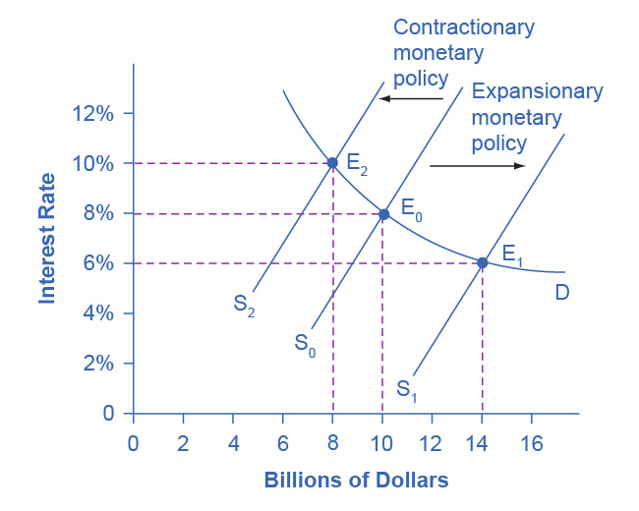
Monetary Policy and Interest Rates
The original equilibrium occurs at E₀.
An expansionary monetary policy will shift the supply of loanable funds to the right from the original supply curve (S₀) to the new supply curve (S₁) and to a new equilibrium of E₁, reducing the interest rate from 8% to 6%.
A contractionary monetary policy will shift the supply of loanable funds to the left from the original supply curve (S₀) to the new supply (S₂), and raise the interest rate from 8% to 10%.

Slide 18
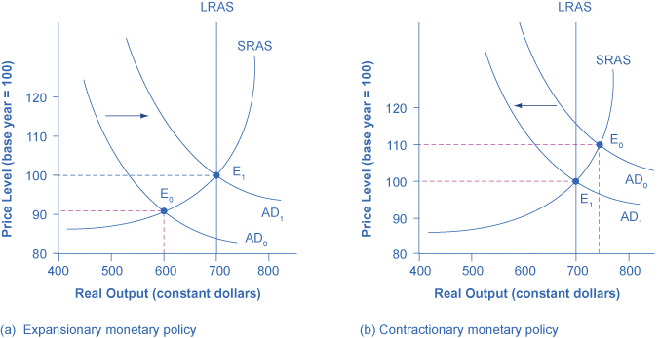
Expansionary or Contractionary Monetary Policy
In (a), the economy is originally in a recession with the equilibrium output and price shown at E₀.
Expansionary monetary policy will reduce interest rates and shift aggregate demand to the right from AD₀ to AD₁,
This leads to the new equilibrium (E₁) at the potential GDP level of output with a relatively small rise in the price level.

Slide 19
Expansionary or Contractionary Monetary Policy, Continued
In (b), the economy is originally producing above the potential GDP level of output at the equilibrium E₀ and is experiencing pressures for an inflationary rise in the price level.
Contractionary monetary policy will shift aggregate demand to the left from AD₀ to AD₁,
This leads to a new equilibrium (E₁) at the potential GDP level of output.

Slide 20
Countercyclical
Monetary policy should be countercyclical.
Countercyclical - moving in the opposite direction of the business cycle of economic downturns and upswings

Slide 21
15.5 Pitfalls for Monetary Policy
Banks are legally required to hold a minimum level of reserves, but no rule prohibits them from holding additional excess reserves.
Excess reserves - reserves banks hold that exceed the legally mandated limit.
Velocity - the speed with which money circulates through the economy.

Slide 22
Unemployment and Inflation
Most central bankers believe that the primary task of monetary policy should be fighting inflation.
This vision of focusing monetary policy on a low rate of inflation is so attractive that many countries have rewritten their central banking laws since the 1990s to have their bank practice inflation targeting.
Inflation targeting - a rule that the central bank is required to focus only on keeping inflation low.
Economists have no final consensus on whether a central bank should be required to focus only on inflation or should have greater discretion.

